Slide 1
Introduction to Python Programming Language and Jupyter Notebook
CS 150
Bellarmine University

Slide 2


Why Programming in Liberal Arts
Data is Everywhere: literature, history archives, surveys, social media
Programming gives you a new set of Research Tools: analyze texts, explore cultural trends, visualize history
Move you from being consumers of digital content to active creators and explorers: digital storytelling, interactive art, digital humanities
Improves your Career Skills: Employers value problem-solving and digital literacy, no matter your field

Slide 3
Why Python?
Beginner-Friendly: simple, readable syntax
Versatile: Widely used across disciplines and for different subjects such as text analysis, data visualization, AI, web projects.
Community Support: tutorials, forums, global community
Libraries for Liberal Arts: NLTK, Pandas, Matplotlib, Pillow
Open source, free and widely available with a massive open-source community

Slide 4
The Python Language
Python is an object-oriented scripting language
Released publicly in 1991
Has rapidly become one of the world’s most popular programming languages
Particularly popular for educational and scientific computing, as well as software prototyping.
Recently surpassed the programming language R as the most popular data-science programming language

Slide 5
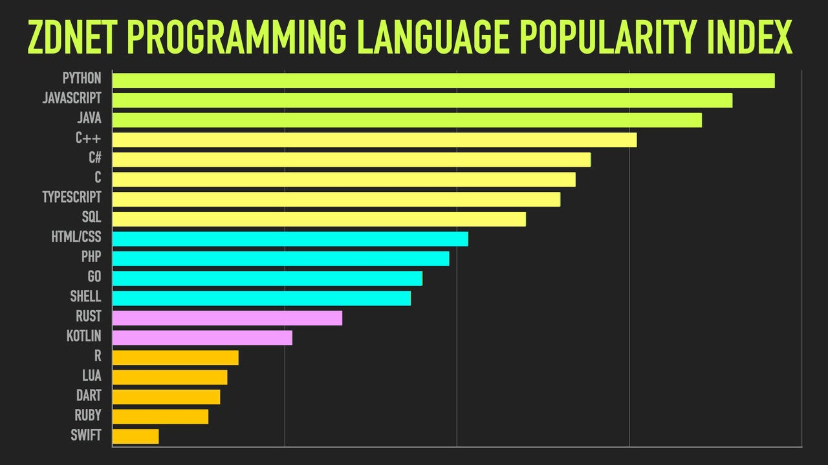
Programming Language Popularity (2025)

Slide 6
Translating a program to machine language
Interpreter
Directly executes the instructions in the source programming language
Read one instruction → Execute it →Read next instruction →Execute ....
Example: Python, JavaScript
(Usually easy to use from scratch!)
Compiler
Translates all the instructions into machine code at a time and then, execute
Read all the machine code instructions →Execute them.
Example: Java, C++

Slide 7
Python Applications
Not always used in final products
Standard Python scripts can be slower than compiled languages (C, C++).
Less efficient in terms of speed and memory.
Task-specific languages may be better
Example: JavaScript for web infrastructure.
Python excels at prototyping
Easy to write, test, and adjust.
Great for building first-draft versions of applications.
Allows rapid experimentation before moving to production-level languages.

Slide 8


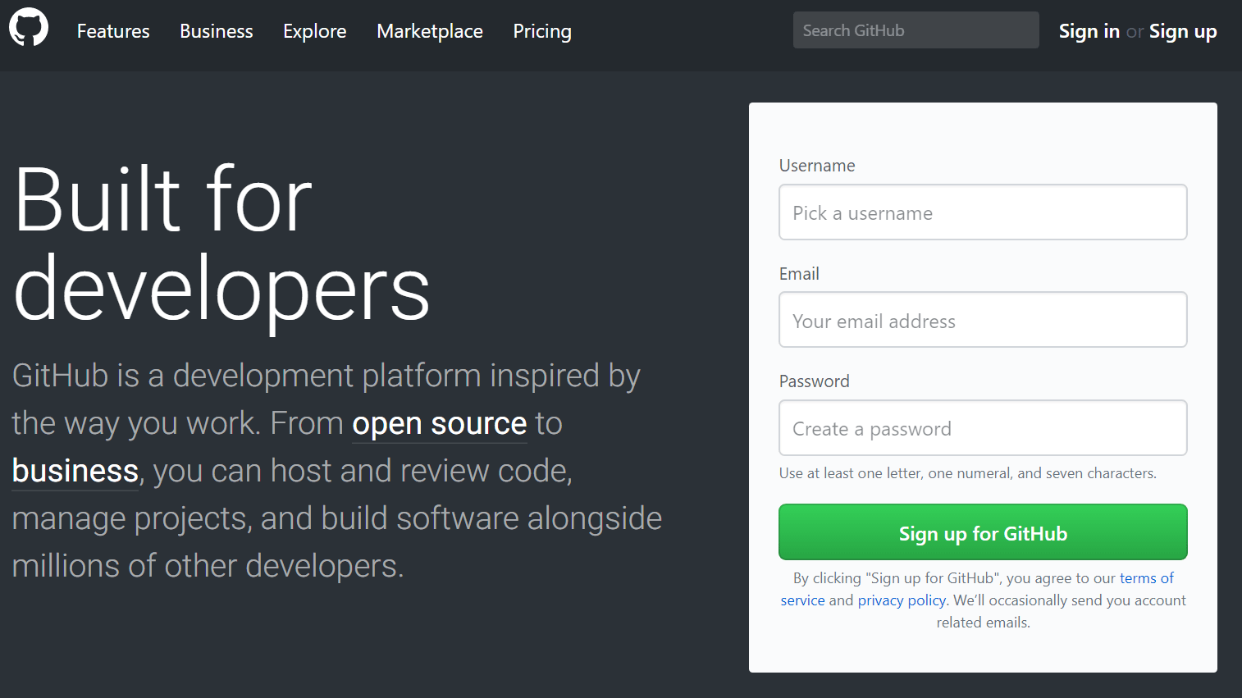
Course Materials
Textbook: Python Crash Course, 2nd Edition: A Hands-On, Project-Based Introduction to Programming
Anaconda Python (https://www.anaconda.com/products/individual)
GitHub Account (https://github.com)

Slide 9
Learning Outcome
Choose the correct programing structures to use for various problems and data structures.
Use Jupyter Notebooks to write interactive Python programs.
Maintain a code repository for sharing code

Slide 10
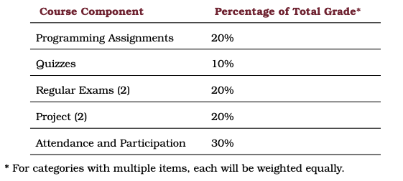
Grading Information
Notes:
5 assignments and 4 quizzes

Slide 11
Python Tools and IDE

Slide 12
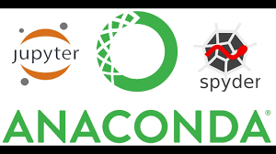
Python Tools and IDEs
Jupyter Notebook
Web-based, interactive coding environment
Combines code, text, visuals, and analysis in one document
Perfect for experiments, tutorials, and projects
Spyder
Integrated Development Environment (IDE)
Offers debugging, variable tracking, and multi-file projects
Useful for larger projects but more technical
Other Options
VS Code: Professional coding environment with Python extensions
Google Colab: Free cloud-based Jupyter environment, no installation needed

Slide 13
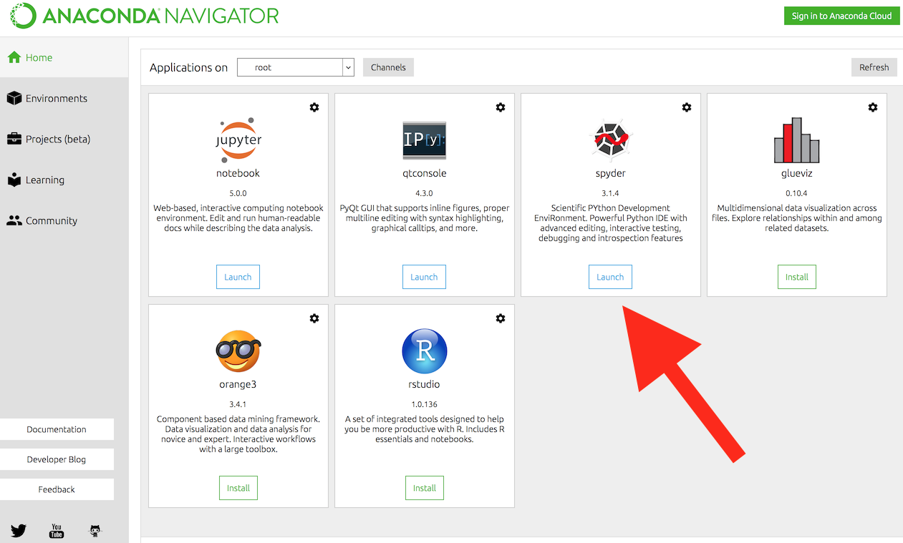
Downloading Anaconda
Visit https://www.anaconda.com/download and click “Get Started”
Select suitable operating system (Windows/MacOS/Linux) where the three operating systems are listed
Download ...
Open and run the installer ...
Open the Anaconda Prompt from the start menu:
Windows: Click Start, search Anaconda Prompt from the menu.
MacOS: Cmd+Space to open Spotlight Search and
type “Navigator” to open the program.
Linux: Open Applications - System Tools - terminal.
Terminal – type python --version

Slide 14
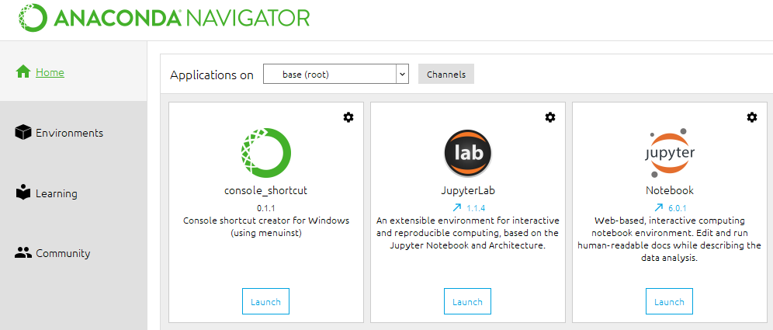
Work with Jupyter Notebook
A notebook integrates code and its output into a single document that combines visualizations, narrative text, mathematical equations, and other rich media.
In other words: it's a single document where you can run code, display the output, add explanations, formulas, charts, and make your work more transparent, understandable, repeatable, and shareable
Note: there are many ways to start up Jupyter Notebook from the Anaconda environment. The simplest is through the Navigator GUI

Slide 15
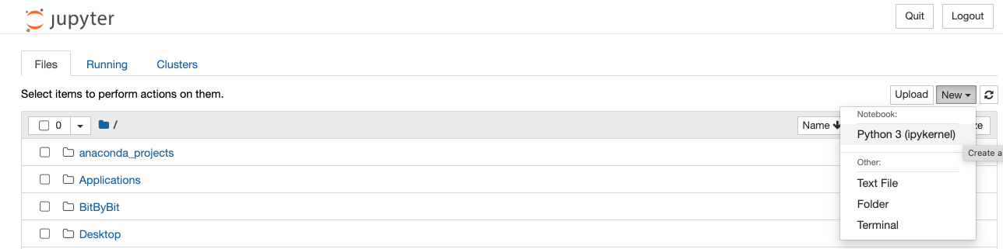
Create a new file

Slide 16
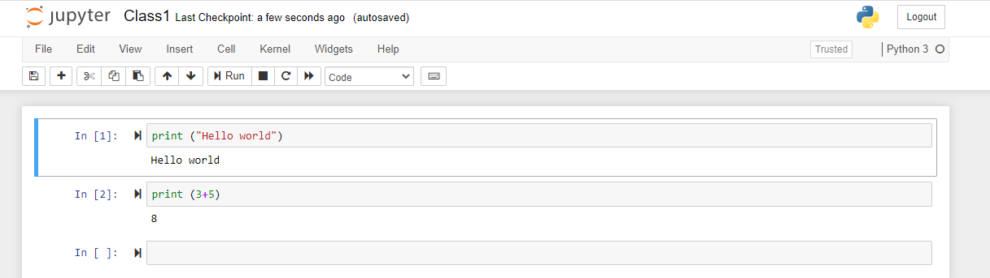
Your first program-Jupyter Notebook
Traditional ‘Hello World’ program in Python
We will examine this program in the next section
Typing the program into your IDE would be good practice!
Be careful of spelling e.g., ‘print’ vs. ‘primt’
Python is case sensitive.

Slide 17
End

